Slide 1
RankSQL:
Query Algebra and Optimization for Relational Top-k Queries
Chengkai Li (UIUC)
joint work with
Kevin Chen-Chuan Chang (UIUC)
Ihab F. Ilyas (U. of Waterloo)
Sumin Song (UIUC)

Slide 2
Ranking (Top-k) Queries
Ranking is an important functionality in many real-world database applications:
E-Commerce, Web Sources
Find the best hotel deals by price, distance, etc.
Multimedia Databases
Find the most similar images by color, shape, texture, etc.
Text Retrieval, Search Engine
Find the most relevant records/documents/pages.
OLAP, Decision Support
Find the top profitable customers to send ads.

Slide 3
Example: Trip Planning
Suggest a hotel to stay and a museum to visit:
hotel | museum | cheap | close | related | score
h1 | m2 | 0.9 | 0.7 | 0.8 | 2.4
h2 | m1 | 0.6 | 0.8 | 0.9 | 2.3
h1 | m3 | 0.9 | 0.7 | 0.6 | 2.2
Select *
From
Hotel h, Museum m
Where
h.star=3 AND
h.area=m.area
Order By
cheap(h.price) +
close(h.addr, “BWI airport”) +
related(m.collection,“dinosaur”)
Limit 5
membership dimension:
Boolean predicates,
Boolean function
B
R
order dimension:
ranking predicates,
monotonic scoring function

Slide 4
Processing Ranking Queries in Traditional RDBMS
5 results
Select *
From
Hotel h, Museum m
Where
B
Order By
R
Limit 5
R
sort cheap+close+related
B
h.area=m.area
σh.star=3
scan(m)
scan(h)

Slide 5
Problems of Traditional Approach
Naïve Materialize-then-Sort scheme
Overkill:
total order of all results;
only 5 top results are requested.
Very inefficient:
  Scan large base tables;
  Join large intermediate results;
  Evaluate every ranking on every tuple;
  Full sorting.
5 results
R
B

Slide 6
Therefore the problem is:
Unlike Boolean constructs, ranking is second class.
  Ranking is processed as a Monolithic component (R ), always after the Boolean component (B).

Slide 7
How did we make Boolean “first class”?
Select *
From
Hotel h, Museum m
Where
h.star=3 AND
h.area=m.area
σ h.star=3 AND h.area=m.area
Hotel X Museum
(1) materialize-then-filter

Slide 8
First Class: Splitting and Interleaving
Select *
From
Hotel h, Museum m
Where
h.star=3 AND
h.area=m.area
σ h.star=3 AND h.area=m.area
Hotel X Museum
(1) materialize-then-filter
h.area=m.area
σh.star=3
scan(m)
scan(h)
(2) B is split into joins and selections, which interleave with each other.

Slide 9
Ranking Query Plan
5 results
5 results
R
μclose
sort cheap+close+related
rank-joinh.area=m.area
B
σh.star=3
μrelated
h.area=m.area
σh.star=3
scan(m)
rank-scan(h,cheap)
scan(m)
scan(h)
split and interleave:
reduction of intermediate results, thus processing cost
materialize-then-sort:
naïve, overkill

Slide 10
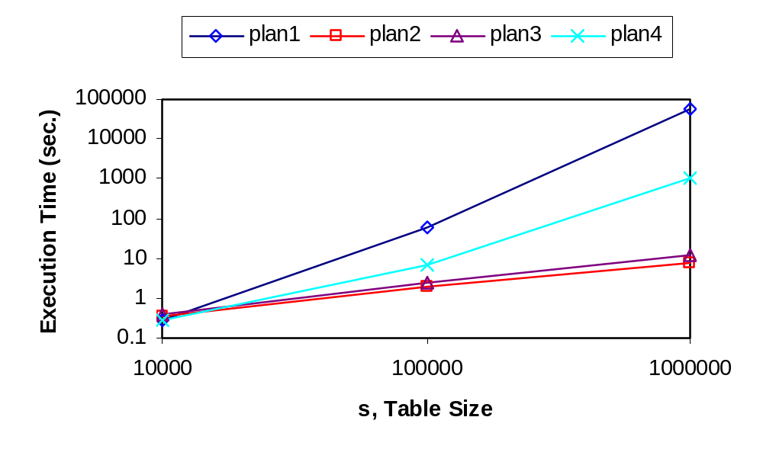
Possibly orders of magnitude improvement
Implementation in PostgreSQL
plan1: traditional materialize-then-sort plan
plan2-4: new ranking query plans
Observations:
an extended plan space with plans of various costs.

Slide 11
RankSQL
Goals:
  Support ranking as a first-class query type in RDBMS;
  splitting ranking.
  Integrate ranking with traditional Boolean query constructs.
  interleaving ranking with other operations.
Foundation: Rank-Relational Algebra
  data model: rank-relation
  operators: new and augmented
  algebraic laws
Query engine:
  executor: physical operator implementation
  optimizer: plan enumeration, cost estimation

Slide 12
Two Logical Properties of Rank-Relation
Membership of the tuples: evaluated Boolean predicates
Order among the tuples: evaluated ranking predciates
rank-relation
Membership(B): h.area=m.area, h.star=3
Order(R): close(h.addr, “BWI airport”)
related(m.collection,“dinosaur”)
cheap(h.price)
B
A
Membership(B): h.star=3
Order(R): cheap(h.price)
rank-relation

Slide 13
Ranking Principle: what should be the order?
F=cheap + close + related
hotel | cheap
h1 | 0.9
h2 | 0.6
… | …
upper bound | museum | close | related
2.9 | * | 1 | 1
2.6 | * | 1 | 1
… | … | … | …
B
tuple h₁
tuple h₂
Upper-bound determines the order:
Without further processing h1, we cannot output any result;
A

Slide 14
Ranking Principle: upper-bound determines the order
F=cheap + close + related
hotel | cheap
h1 | 0.9
h2 | 0.6
… | …
upper bound | museum | close | related
2.9 | * | 1 | 1
2.6 | * | 1 | 1
… | … | … | …
B
tuple h₁
tuple h₂
Upper-bound determines the order:
Without further processing h1, we cannot output any result;
A
Processing in the “promising” order, avoiding unnecessary processing.

Slide 15
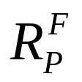
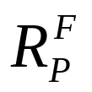
Rank-Relation
Rank-relation
R: relation
F: monotonic scoring function over predicates (p₁, ..., p_{n})
P ⊆ {p₁, . . . , p_{n}}: evaluated predicates
Logical Properties:
  Membership:
  R (as usual)
  Order: <
∀ t1, t2 ∈ : t1 < t2 iff F_{P} [t1] < F_{P} [t2].
(by upper-bound)

Slide 16
Operators
To achieve splitting and interleaving:
New operator:
  μ: evaluate ranking predicates piece by piece.
implementation: MPro (Chang et al. SIGMOD02).
Extended operators:
  rank-selection
  rank-join
  implementation: HRJN (Ilyas et al. VLDB03).
  rank-scan
  rank-union, rank-intersection.

Slide 17
Example
hotel | … | p1 | p2 | p3 | score
h1 |  | 0.7 | 0.8 | 0.9 | 2.4
h2 |  | 0.9 | 0.85 | 0.8 | 2.55
h3 |  | 0.5 | 0.45 | 0.75 | 1.7
h4 |  | 0.4 | 0.7 | 0.95 | 2.05
… |  | … | … | … | …
R_{p1+p2+p3}
hotel
upper-bound
μ_{p3}
R_{p1+p2}
hotel
upper-bound
μ_{p2}
Select *
From Hotel H
Order By p1+p2+p3
Limit 1
R_{p1}
hotel
upper-bound
Scan_{p1}(H)

Slide 18
Example
hotel | … | p1 | p2 | p3 | score
h1
h2 |  | 0.9
h3
h4
…
R_{p1+p2+p3}
hotel | upper-bound
μ_{p3}
R_{p1+p2}
hotel | upper-bound
μ_{p2}
Select *
From Hotel H
Order By p1+p2+p3
Limit 1
R_{p1}
hotel | upper-bound
h2
Scan_{p1}(H)

Slide 19
Example
hotel | … | p1 | p2 | p3 | score
h1 |  | 0.9 | 1.0 | 1.0 | 2.9
h2 |  | 0.9 | 1.0 | 1.0 | 2.9
h3 |  | 0.9 | 1.0 | 1.0 | 2.9
h4 |  | 0.9 | 1.0 | 1.0 | 2.9
… |  | 0.9 | 1.0 | 1.0 | 2.9
R_{p1+p2+p3}
hotel | upper-bound
μ_{p3}
R_{p1+p2}
hotel | upper-bound
μ_{p2}
Select *
From Hotel H
Order By p1+p2+p3
Limit 1
R_{p1}
hotel | upper-bound
h2 | 2.9
Scan_{p1}(H)

Slide 20
Example
hotel | … | p1 | p2 | p3 | score
h1 |  | 0.9 | 1.0 | 1.0 | 2.9
h2 |  | 0.9 | 1.0 | 1.0 | 2.9
h3 |  | 0.9 | 1.0 | 1.0 | 2.9
h4 |  | 0.9 | 1.0 | 1.0 | 2.9
… |  | 0.9 | 1.0 | 1.0 | 2.9
R_{p1+p2+p3}
hotel | upper-bound
μ_{p3}
R_{p1+p2}
hotel | upper-bound
h2 2.9
μ_{p2}
Select *
From Hotel H
Order By p1+p2+p3
Limit 1
R_{p1}
hotel | upper-bound
h2 | 2.9
Scan_{p1}(H)

Slide 21
Example
hotel | … | p1 | p2 | p3 | score
h1 |  | 0.9 | 1.0 | 1.0 | 2.9
h2 |  | 0.9 | 0.85 | 1.0 | 2.75
h3 |  | 0.9 | 1.0 | 1.0 | 2.9
h4 |  | 0.9 | 1.0 | 1.0 | 2.9
… |  | 0.9 | 1.0 | 1.0 | 2.9
R_{p1+p2+p3}
hotel | upper-bound
μ_{p3}
R_{p1+p2}
hotel | upper-bound
h2 | 2.75
μ_{p2}
Select *
From Hotel H
Order By p1+p2+p3
Limit 1
R_{p1}
hotel | upper-bound
h2 | 2.9
Scan_{p1}(H)

Slide 22
Example
hotel | … | p1 | p2 | p3 | score
h1 |  | 0.7 | 1.0 | 1.0 | 2.7
h2 |  | 0.9 | 0.85 | 1.0 | 2.75
h3 |  | 0.7 | 1.0 | 1.0 | 2.7
h4 |  | 0.7 | 1.0 | 1.0 | 2.7
… |  | 0.7 | 1.0 | 1.0 | 2.7
R_{p1+p2+p3}
hotel | upper-bound
μ_{p3}
R_{p1+p2}
hotel | upper-bound
h2 | 2.75
μ_{p2}
Select *
From Hotel H
Order By p1+p2+p3
Limit 1
R_{p1}
hotel | upper-bound
h2 | 2.9
h1 | 2.7
Scan_{p1}(H)

Slide 23
Example
hotel | … | p1 | p2 | p3 | score
h1 |  | 0.7 | 0.8 | 1.0 | 2.5
h2 |  | 0.9 | 0.85 | 1.0 | 2.75
h3 |  | 0.7 | 1.0 | 1.0 | 2.7
h4 |  | 0.7 | 1.0 | 1.0 | 2.7
… |  | 0.7 | 1.0 | 1.0 | 2.7
R_{p1+p2+p3}
hotel | upper-bound
μ_{p3}
R_{p1+p2}
hotel | upper-bound
h2 | 2.75
h1 | 2.5
μ_{p2}
Select *
From Hotel H
Order By p1+p2+p3
Limit 1
R_{p1}
hotel | upper-bound
h2 | 2.9
h1 | 2.7
Scan_{p1}(H)

Slide 24
Example
hotel | … | p1 | p2 | p3 | score
h1 |  | 0.7 | 0.8 | 1.0 | 2.5
h2 |  | 0.9 | 0.85 | 0.8 | 2.55
h3 |  | 0.7 | 1.0 | 1.0 | 2.7
h4 |  | 0.7 | 1.0 | 1.0 | 2.7
… |  | 0.7 | 1.0 | 1.0 | 2.7
R_{p1+p2+p3}
hotel | upper-bound
h2 | 2.55
μ_{p3}
R_{p1+p2}
hotel | upper-bound
h2 | 2.75
h1 | 2.5
μ_{p2}
Select *
From Hotel H
Order By p1+p2+p3
Limit 1
R_{p1}
hotel | upper-bound
h2 | 2.9
h1 | 2.7
Scan_{p1}(H)

Slide 25
Example
hotel | … | p1 | p2 | p3 | score
h1 |  | 0.7 | 0.8 | 1.0 | 2.5
h2 |  | 0.9 | 0.85 | 0.8 | 2.55
h3 |  | 0.5 | 1.0 | 1.0 | 2.5
h4 |  | 0.5 | 1.0 | 1.0 | 2.5
… |  | 0.5 | 1.0 | 1.0 | 2.5
R_{p1+p2+p3}
hotel | upper-bound
h2 | 2.55
μ_{p3}
R_{p1+p2}
hotel | upper-bound
h2 | 2.75
h1 | 2.5
μ_{p2}
Select *
From Hotel H
Order By p1+p2+p3
Limit 1
R_{p1}
hotel | upper-bound
h2 | 2.9
h1 | 2.7
h3 | 2.5
Scan_{p1}(H)

Slide 26
Example
hotel | … | p1 | p2 | p3 | score
h1 |  | 0.7 | 0.8 | 1.0 | 2.5
h2 |  | 0.9 | 0.85 | 0.8 | 2.55
h3 |  | 0.5 | 0.45 | 1.0 | 1.95
h4 |  | 0.5 | 1.0 | 1.0 | 2.5
… |  | 0.5 | 1.0 | 1.0 | 2.5
R_{p1+p2+p3}
hotel | upper-bound
h2 | 2.55
μ_{p3}
R_{p1+p2}
hotel | upper-bound
h2 | 2.75
h1 | 2.5
h3 | 1.95
μ_{p2}
Select *
From Hotel H
Order By p1+p2+p3
Limit 1
R_{p1}
hotel | upper-bound
h2 | 2.9
h1 | 2.7
h3 | 2.5
Scan_{p1}(H)

Slide 27
Example
hotel | … | p1 | p2 | p3 | score
h1 |  | 0.7 | 0.8 | 0.9 | 2.4
h2 |  | 0.9 | 0.85 | 0.8 | 2.55
h3 |  | 0.5 | 0.45 | 1.0 | 1.95
h4 |  | 0.5 | 1.0 | 1.0 | 2.5
… |  | 0.5 | 1.0 | 1.0 | 2.5
R_{p1+p2+p3}
hotel | upper-bound
h2 | 2.55
h1 | 2.4
μ_{p3}
R_{p1+p2}
hotel | upper-bound
h2 | 2.75
h1 | 2.5
h3 | 1.95
μ_{p2}
Select *
From Hotel H
Order By p1+p2+p3
Limit 1
R_{p1}
hotel | upper-bound
h2 | 2.9
h1 | 2.7
h3 | 2.5
Scan_{p1}(H)

Slide 28
Example
hotel | … | p1 | p2 | p3 | score
h1 |  | 0.7 | 0.8 | 0.9 | 2.4
h2 |  | 0.9 | 0.85 | 0.8 | 2.55
h3 |  | 0.5 | 0.45 | 1.0 | 1.95
h4 |  | 0.5 | 1.0 | 1.0 | 2.5
… |  | 0.5 | 1.0 | 1.0 | 2.5
R_{p1+p2+p3}
hotel | upper-bound
h2 | 2.55
h1 | 2.4
μ_{p3}
R_{p1+p2}
hotel | upper-bound
h2 | 2.75
h1 | 2.5
h3 | 1.95
μ_{p2}
Select *
From Hotel H
Order By p1+p2+p3
Limit 1
R_{p1}
hotel | upper-bound
h2 | 2.9
h1 | 2.7
h3 | 2.5
Scan_{p1}(H)

Slide 29
In contrast: materialize-then-sort
hotel | … | p1 | p2 | p3 | score
h1 |  | 0.7 | 0.8 | 0.9 | 2.4
h2 |  | 0.9 | 0.85 | 0.8 | 2.55
h3 |  | 0.5 | 0.45 | 0.75 | 1.7
h4 |  | 0.4 | 0.7 | 0.95 | 2.05
… |  | … | … | … | ….
Sort_{p1+p2+p3}
Select *
From Hotel H
Order By p1+p2+p3
Limit 1
Scan(H)

Slide 30
Impact of Rank-Relational Algebra
parser,
rewriter
Ranking Query
operators and algebraic laws
Logical Query Plan
optimizer
Plan enumerator
cost model
Physical Query Plan
implementation of operators
Results
executor

Slide 31
Optimization
Two-dimensional enumeration:
  ranking (ranking predicate scheduling)
  and
  filtering (join order selection)
Sampling-based cardinality estimation

Slide 32
Two-Dimensional Enumeration
(1 table, 0 predicate)
seqScan(H), idxScan(H), seqScan(M), …
(1 table, 1 predicate)
rankScan_{cheap}(H), μ_{cheap}(seqScan(H)), …
(1 table, 2 predicates)
μ_{close}(rankScan_{cheap}(H)), …
(2 table, 0 predicate)
NestLoop(seqScan(H), seqScan(M)), …
(2 table, 1 predicate)
NRJN(rankScan_{cheap}(H), seqScan(M)),…
and so on…

Slide 33
Related Work
Middleware
Fagin et al. (PODS 96,01),Nepal et al. (ICDE 99),Günter et al. (VLDB 00),Bruno et al. (ICDE 02),Chang et al. (SIGMOD 02)
RDBMS, outside the core
Chaudhuri et al. (VLDB 99),Chang et al. (SIGMOD 00), Hristidis et al. (SIGMOD 01), Tsaparas et al. (ICDE 03), Yi et al. (ICDE 03)
RDBMS, in the query engine
  Physical operators and physical properties
  Carey et al. (SIGMOD 97), Ilyas et al. (VLDB 02, 03, SIGMOD 04), Natsev et al. (VLDB 01)
  Algebra framework
Chaudhuri et al. (CIDR 05)

Slide 34
Conclusion: RankSQL System
Goal:
Support ranking as a first-class query type;
Integrate ranking with Boolean query constructs.
Our approach:
  Algebra: rank-relation,
    new and augmented rank-aware operators,
    algebraic laws
  Optimizer: two-dimensional enumeration,
    sampling-based cost estimation
Implementation: in PostgreSQL
Welcome to our demo in VLDB05!

